Slide 1
BDm Project Revenue Analysis of “J.K. Textile Traders & Manufacturer” business model and measures to maximize the overall profit.
By Jay Kashyap
21f1002984
Iitm bs data science & applications

Slide 2

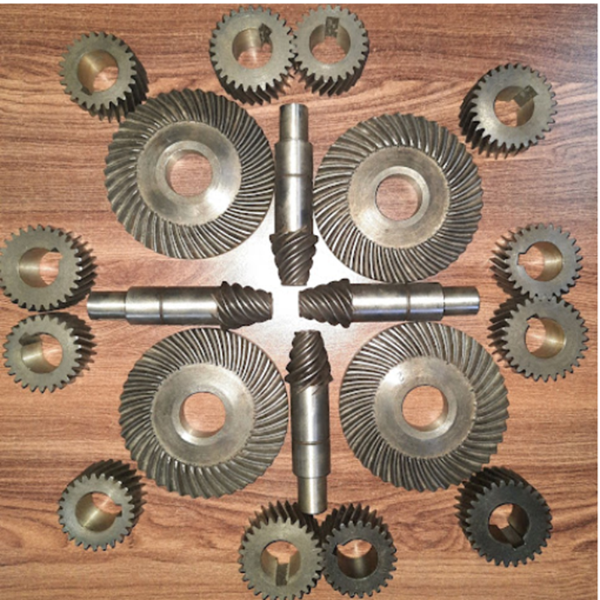
Organisation Background
Industrial Machinery Spare Parts Supplier
SINCE 1992
They started their work from a small room with a funding of ₹ 3000 to a factory which grew slowly and gradually over the past 30 years successfully.
At their company, they pride themselves on exceptional quality. From the initial concept to the final product, their attention to detail is second to none. In an ever-evolving industry, J.K. Textile Traders & Manufacturer is successfully Manufacturing, Repairing, and Supplying all types of Industrial Machinery Parts for the last 30 years. By their goods you can see for yourself - they love their work and they’re sure you will, too.

Slide 3
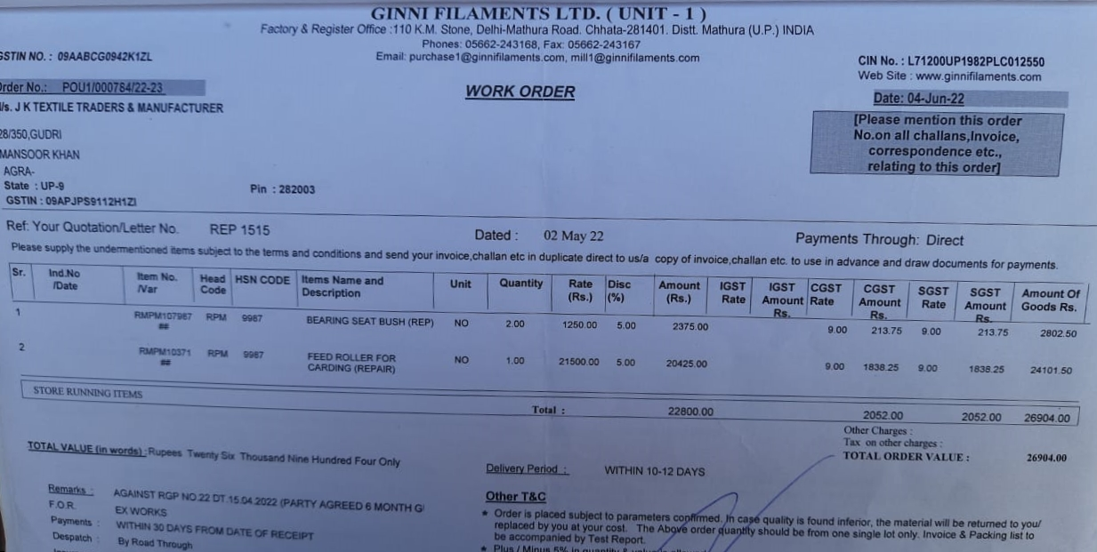
Raw Data

Slide 4
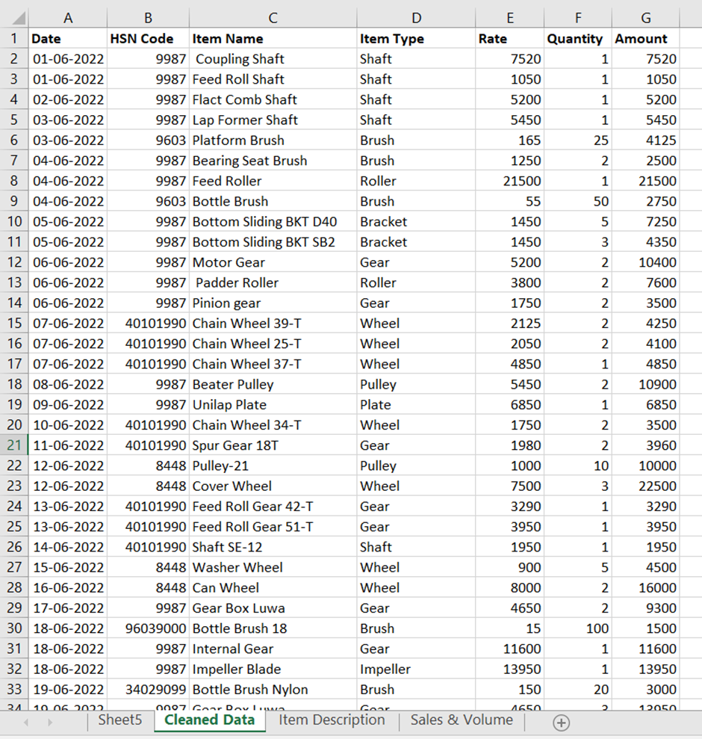
META-DATA
After cleaning the data, the changes done by me are -
The removal of discount factor as it is same for all bill invoices and didn’t vary so it wont help us to conclude anything in data analysis.
The removal of GST as this amount of tax is meant for government only and won’t conclude anything in data analysis.
The final amount is a product of Rate & Quantity only.

Slide 5
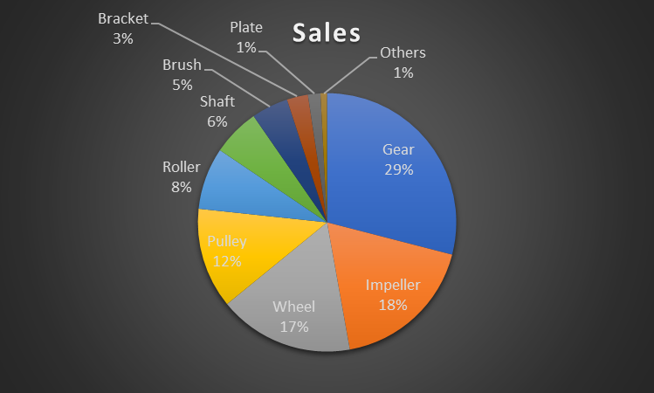
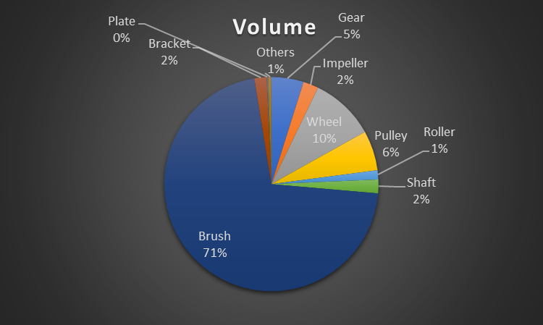
Results and Findings
Gear , Impeller , Wheel & Pulley are the four products that generates 76% of revenue .
Brush has 71% contribution in Volume.

Slide 6
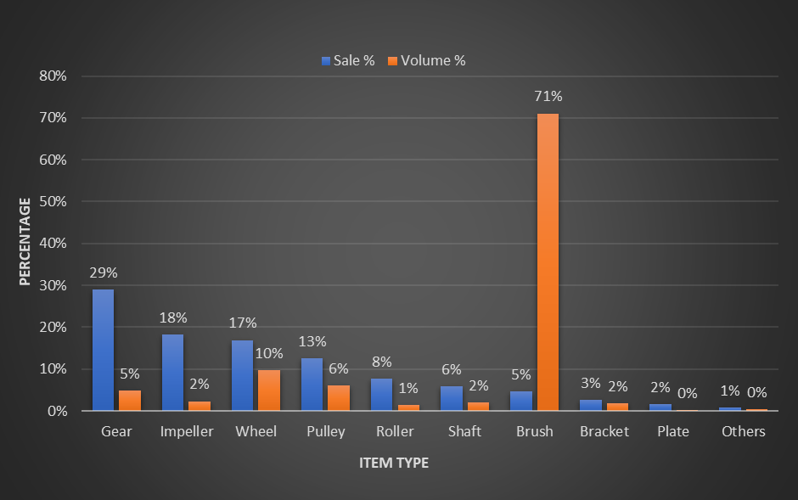
Comparison between Sales & Volume
Gear & Impeller are high contributors of revenue with low gross margin contribution of volume.
Wheel & Pulley are the safest component maintaining stability in both revenue as well as volume.
Brush can be seen as outlier in terms of volume contribution.

Slide 7
Recommendations
As mentioned earlier “J K Textile Traders & Manufacturer” has a foothold of 30 years in industry so they should try to have supplier demand.
Inventory should be managed according to Volume so that they can minimize Stock-outs and Stock-Pile and make the best and optimal revenue.
This organisation should use Overall Equipment Effectiveness to reduce scrap as due to overheating of machine scrap production increases which leads to loss of raw material and that raw material cannot be reused again, so just increasing the performance rate and decreasing the scrap production will leads to optimal and maximized revenue.
Penetrative Pricing – To reduce Substitutes as well as New Entry Threats.
Effective Logistics – Usage of good logistics which maintains their transport system so that the goods are not damaged in the process of transportation.

Slide 8
THANK YOU

